Slide 1
DDS_FLS_Unit_10
Matthew David, Last edited:

Slide 2
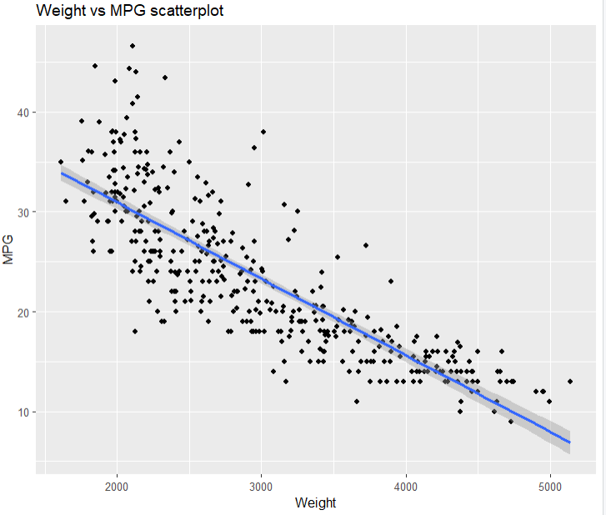
Checking the Assumptions
Normality: There is sufficient evidence to suggest the data is not normally distributed however if we look at the range of mpg < 40 then it meets our assumption of normality.

Slide 3
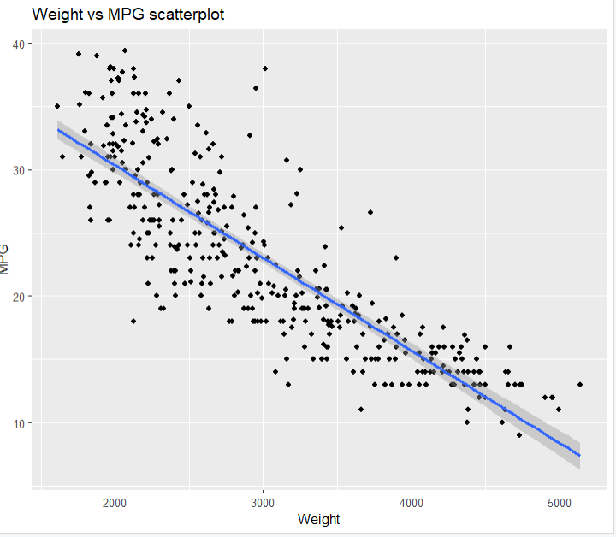
Checking the Assumptions
There is not enough sufficient evidence to suggest that the data is not normally distributed
there is not enough evidence against a linear relationship
There does not appear to be evidence against a non constant standard deviation
We will assume the MPG and weights are independent from each other.

Slide 4
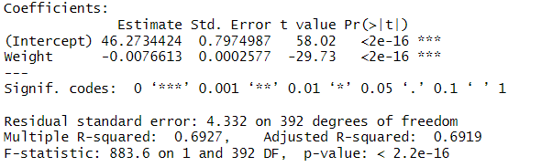
Linear model MPG vs Weight
Equation: MPG= 46.273 - 0.008(Weight)
Code:
cars = read.csv(file.choose())
fit= lm(MPG~Weight, data = cars)
summary(fit)

Slide 5


Six step hypothesis test
Ho: slope = 0 Ha slope != 0
Critical value = -1.966
Test statistic = -29.73
P-value = < 0.0001
Reject Ho
Conclusion: There is overwhelming evidence to suggest that the slope in regards to MPG vs Weight is different from zero(p-value <0.0001). We ar3 95% confident that the true slope resides in the interval(-0.008,-0.007)
For every 1000 lbs increase in Weight of the car it is estimated that the MPG will decrease by -0.008. We are 95% confident that the slope is between the confidence interval(-0.008,-0.007)

Slide 6
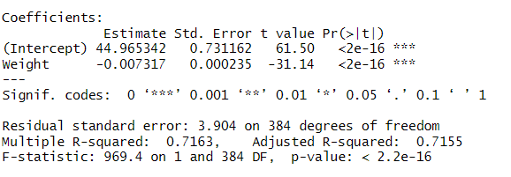
Linear model MPG<40 vs Weight
Equation: MPG=44.965-0.008
Code:
fit2= lm(MPG~Weight, data = cars2)
summary(fit2)
confint(fit2)

Slide 7


Six step hypothesis test mpg<40
Ho: slope = 0 Ha slope != 0
Critical value = -1.966
Test statistic = -31.14
P-value = < 0.0001
Reject Ho
Conclusion: There is overwhelming evidence to suggest that the slope in regards to MPG under 40 mpg vs Weight is different from zero(p-value <0.0001). We are 95% confident that the true slope resides in the interval(-0.008,-0.007)
For every 1000 lbs increase in Weight of the car it is estimated that the MPG will decrease by -0.008. We are 95% confident that the slope is between the confidence interval(-0.008,-0.007)

Slide 8
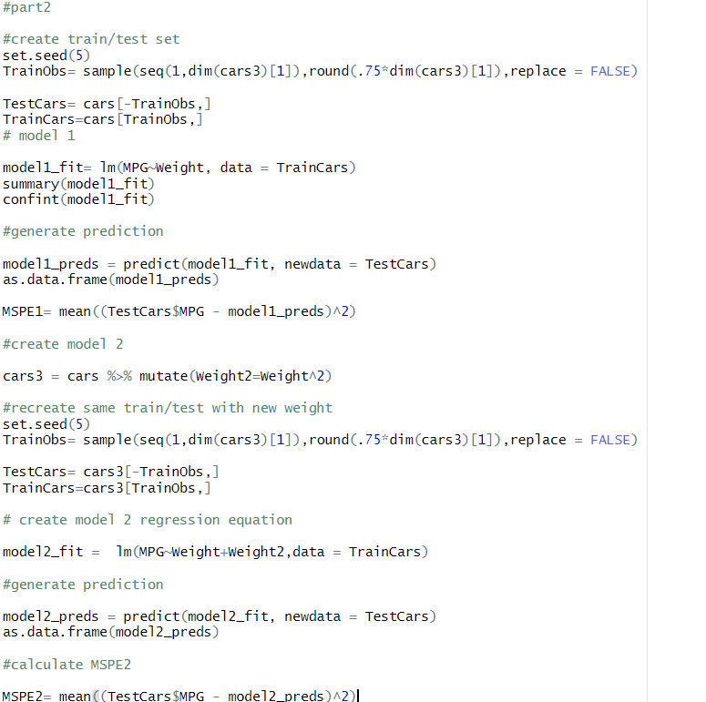
Cross validation of SLR models
Model 1: mpg= Bo+B1weight
MSPE= 16.07
Model 2: mpg = Bo + B1 Weight + B2Weight^2
MSPE = 13.73

Slide 9


Cross validation pt 2
C. Model 2 is favored by the cross validation as it has a smaller MSPE value of 13.73
D. For every 1000 lbs increase in Weight of the car it is estimated that the MPG will decrease by -0.018. We are 95% confident that the slope is between the confidence interval(-0.022,-0.015)

Slide 10

Cross validation pt.3
E. The predicted mean mpg for a car that weighs 2000 lbs is 32.079.We are 95 % confident that the predicted mean mpg is between the interval(31.331, 32.827)

Slide 11

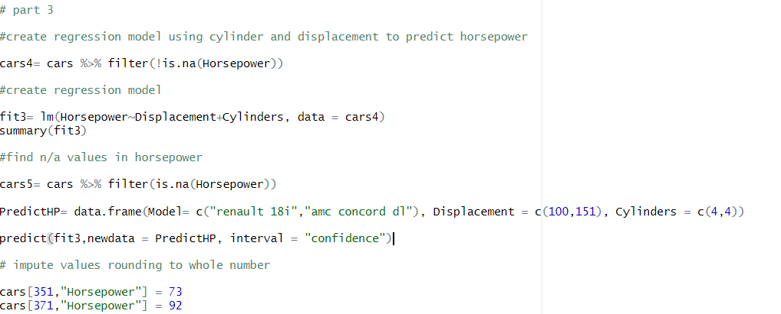
Impute missing values for Horsepower
I used Cylinder and Displacement as explanatory variables to predict Horsepower
Displacement and Cylinders are closely related to engines ability to produce power
Steps
Create new dataframe without missing values in Horsepower
Make regression model: Horsepower = Bo + B1Displacement + B2 Cylinder
find missing values and their correlated values for Cylinders and Displacement
Create dataframe with their values for Cylinder and Displacement
Using model predict their corresponding Horsepower
Input estimated Horsepower into dataset

Slide 12
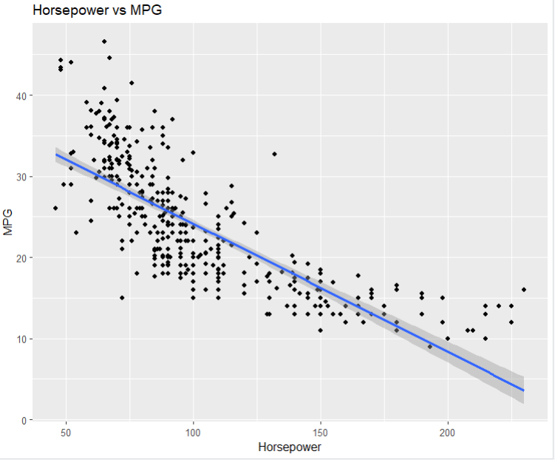
Relationship between MPG and Horsepower
Equation: MPG = Bo + B1 Horsepower
For every 50 increase in Horsepower it is estimated that the MPG will decrease by (-.158). We are p5% confident that the slope is between the confidence interval( -0.170,-0.145)
The estimated mean MPG for a car with 250 horsepower is 0.44, however it's important to note that the linear model might not extend to 250 mpg , so making this assumption could be a stretch.

Slide 13
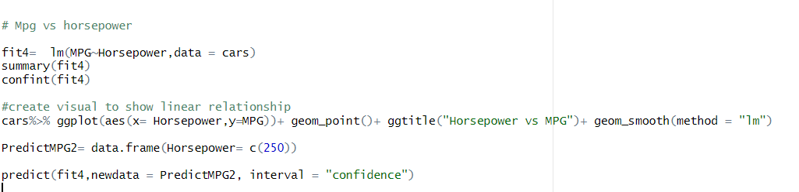
Code

Slide 14
Takeaways and Questions
It appeared that the data was not normally distributed so i looked at mpg>40 however got similar results so i used the full dataset for the rest of the problems, is mpg normally distributed? And did i waste my time ?
For question 2 part d-e I used the model I found had the lower MSPE and used it on the whole dataset for these step did i do this right ? or was i suppose to still utilize the train-test datasets.

